Slide 1
DTSA 5510 Unsupervised Learning Project Atrial Fibrillation Cluster Analysis

Slide 2
Objectives
Cluster AF Patients
Characterizing Cluster Phenotypes
Risk Stratification with Redo Ablation

Slide 3
Data Description
https://physionet.org/content/shdb-af/1.0.1/
Years 2019 and 2023
128 ECG records (24 hours)
ECGs are stored in WFDB format
Patient data was anonymized per HIPAA, with random 3-digit ID
Various demographic data obtained
Github: https://github.com/Vorlon41/Master-of-Data-Science-CU-Boulder-Colorado/tree/main/Machine%20Learning/DTSA%205510%20Unsupervised%20Algorithms%20in%20Machine%20Learning/Final

Slide 4
Pre-Processing
ECG Extraction
Loaded the ECG and attached it to the dataset per patient ID
Detect R to R peaks
Obtain heart rate variability
Obtain entropy values
Then append to the final dataset
Evaluate for missing data
Dropped columns with 100% missing
Some columns were missing because 1 = yes, and 0 = no, impute 0
For less % missing, impute mean for continuous variables
For columns with multiple categorigal values
Used one-hot encoding

Slide 5
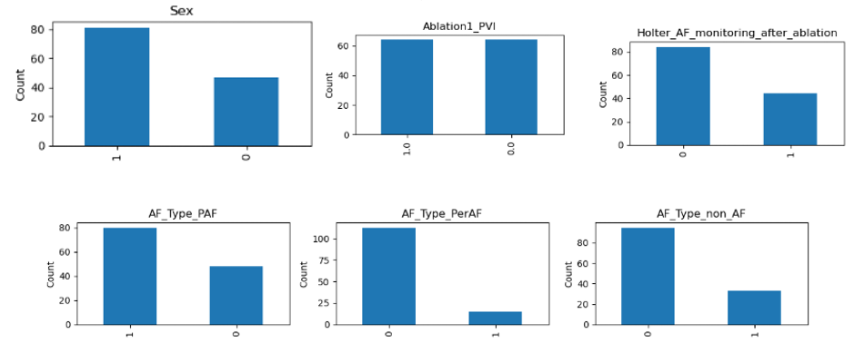
Exploratory Data Analysis
Slightly more males
Slightly less monitoring after ablation
Slightly more paroxysmal than persistent
A decent amount of non-AF

Slide 6
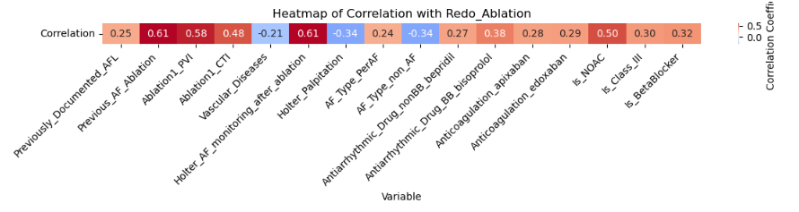
EDA: Biserial Correlation
AF monitoring
Previous ablation
PVI
NOAC
CTI

Slide 7
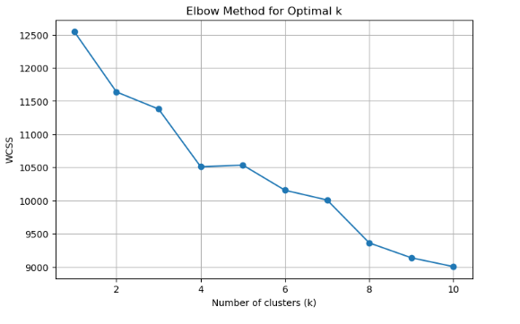
Machine Learning Models
K means
Elbow method
Suggests k = 3, 4

Slide 8
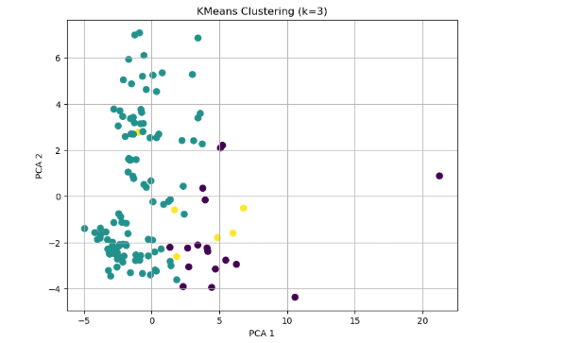
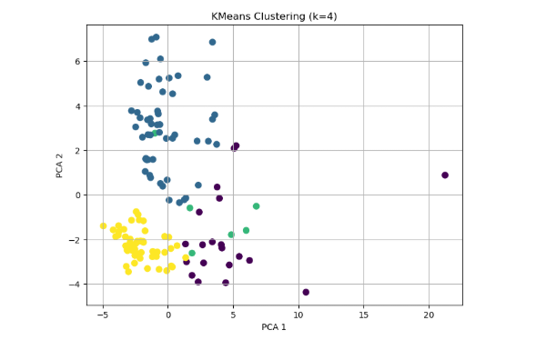
K means
Top k = 3
Bottom k = 4
More interpretable and meaningful separation of the data

Slide 9
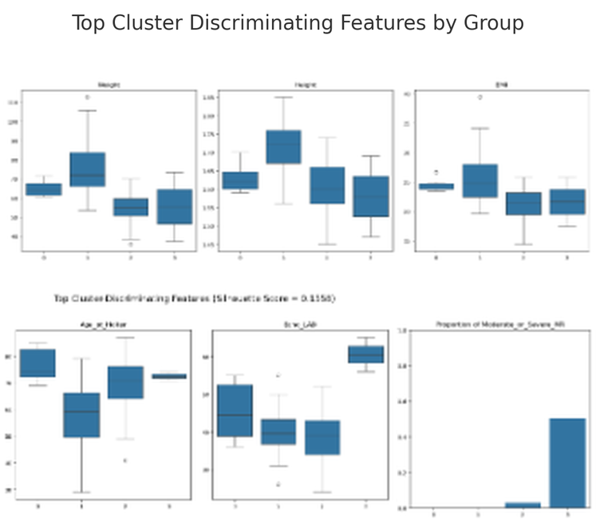
K means
Weight
Height
BMI
Age
ECHO LAD
Mod/Severe MR

Slide 10
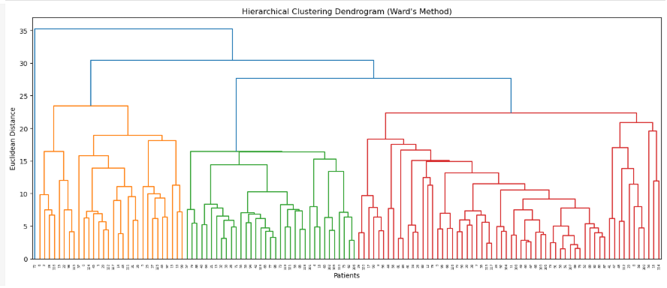
Hierarchical
Dendrogram
There appear to be three to four major groupings

Slide 11
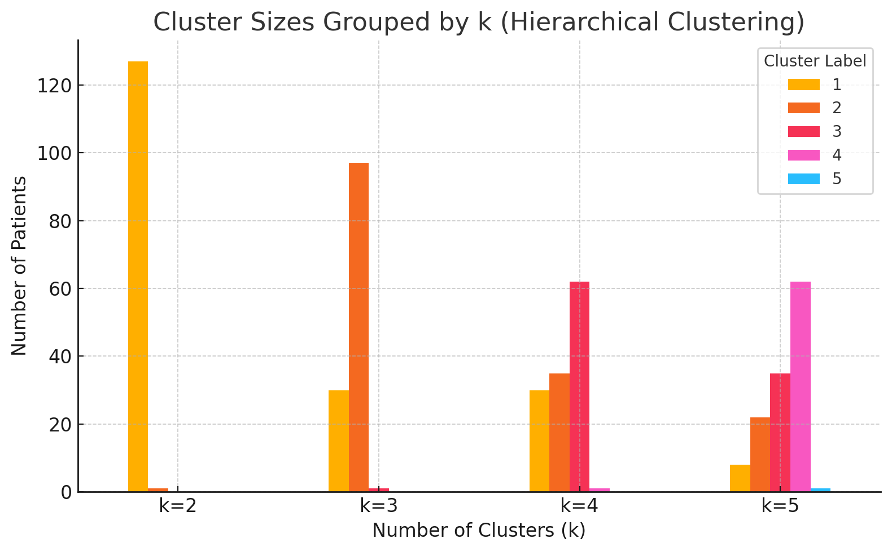
Hierarchical
Cluster Groups
Good separation at 3
More granular at 5

Slide 12
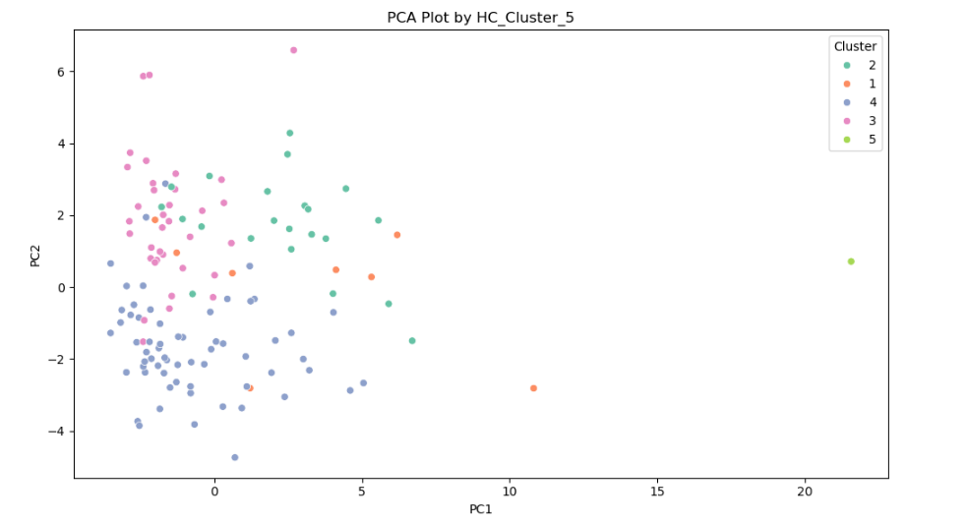
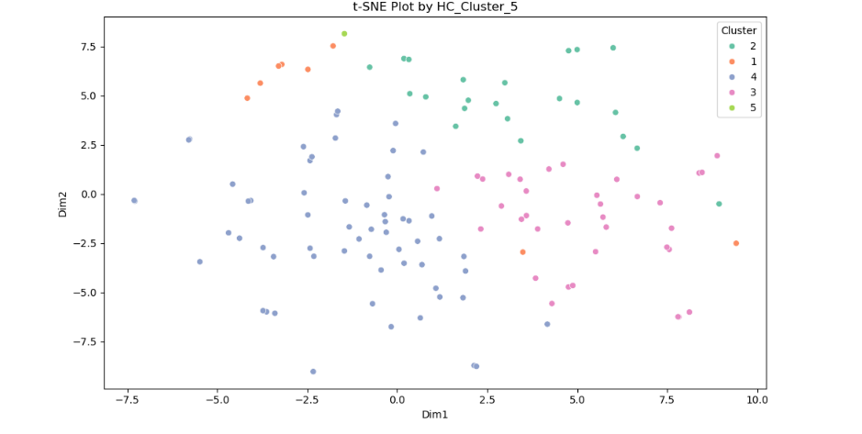
PCA
Distinct clustering patterns emerge, particularly for Clusters 3 and 4, which show tighter groupings, indicating internal similarity.
Cluster 1 appears more dispersed, suggesting greater intra-cluster variability. Cluster 5, stands alone far from the centroid
t-SNE
Non-linear relationships
Reveals clearer separation among Clusters 2, 3, and 4
Cluster 1 remains dispersed with occasional overlap with Cluster 2, while Cluster 5 again appears as a distinct outlier

Slide 13
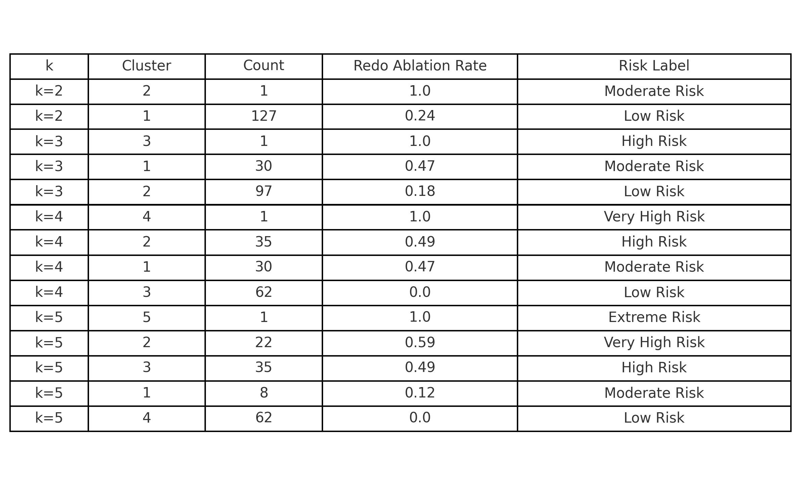
Hierarchical: Risk Stratification
Clearer structure k=3
Further refinement k=4
Most detailed risk stratification k =5

Slide 14
Summary
Cluster 1: Moderate Risk of Redo Ablations
Moderate proportions of females, prior AF ablation, and AF interventions (PVI,CTI)
Higher prevalence of comorbidities, HTN, DM, CVA
Represents a moderate-risk group with significant clinical burden
Cluster 2: Very High Risk of Redo Ablations
High proportions of CTI ablation and moderate PVI
Moderate prior AF ablation but lower comorbidity rates overall
Suggests a procedurally treated but relatively healthier group aside from AF
Cluster 3 (Largest): High Risk of Redo Ablations
Very high rates of AF interventions and prior AF ablation
Indicates a population with aggressive rhythm management and extensive procedural history
Represent chronic AF patients or those with persistent symptoms
Cluster 4: Low Risk of Redo Ablations
Lowest rates of intervention and comorbidities
Very low prior ablation and minimal device usage
Reflects a low-risk, early-stage AF population managed conservatively
Cluster 5: Highest Risk of Redo Ablations or Extreme Risk
100% prevalence of PVI, CTI, prior AF ablation
Clearly an outlier case, highly treated and potentially representing a complex, refractory AF profile

